Slide 1
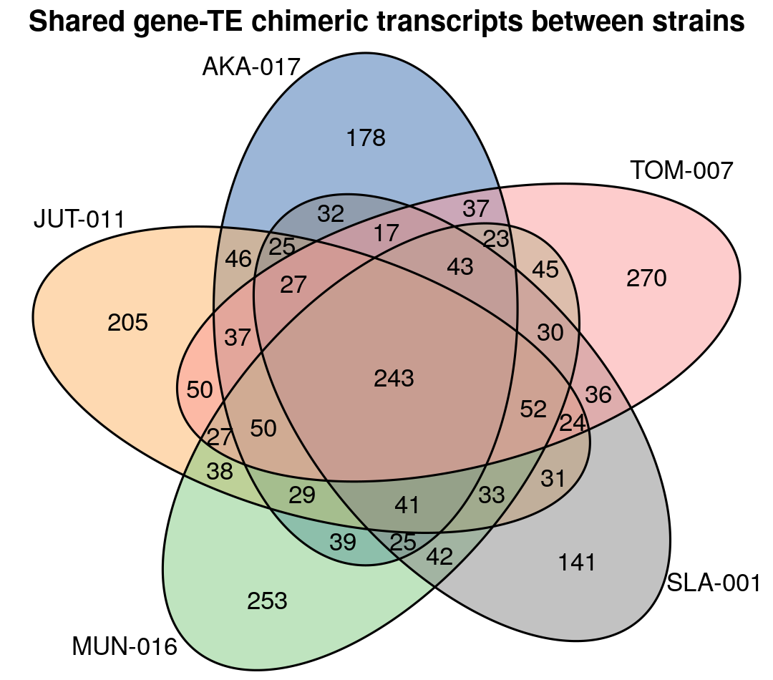
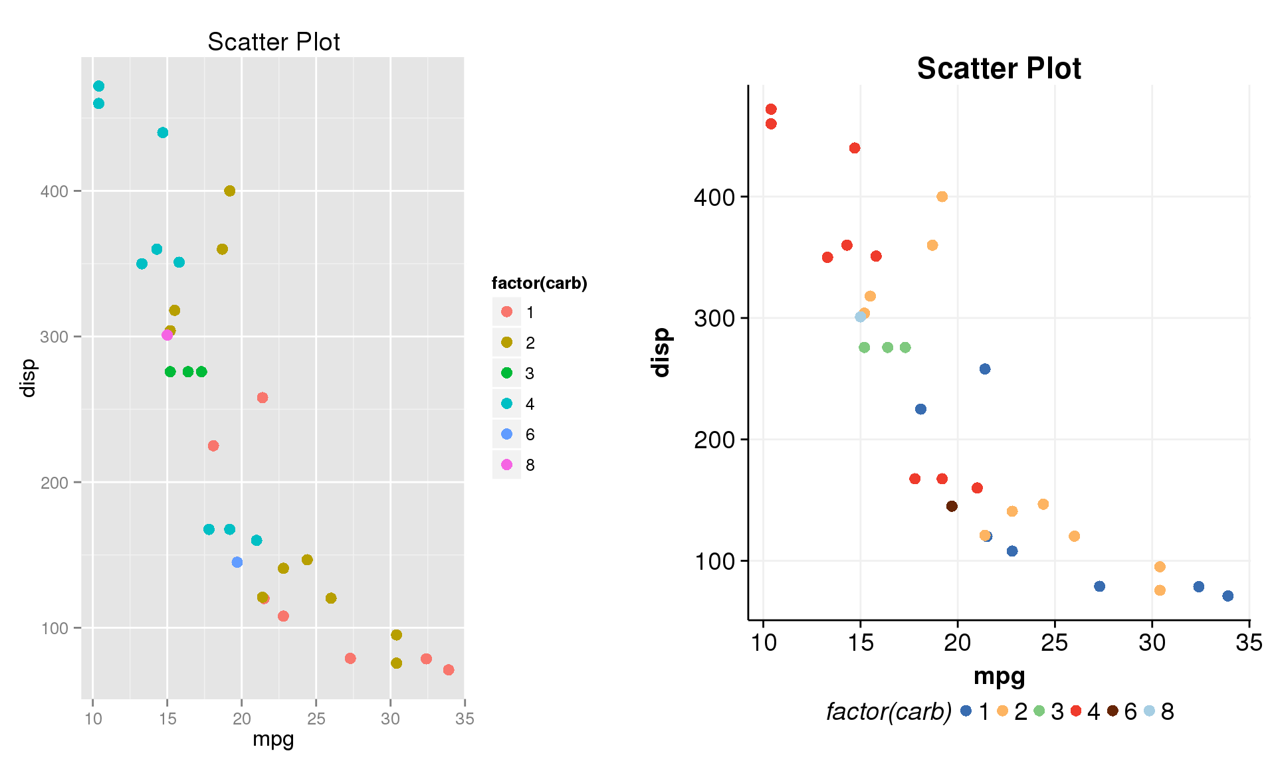
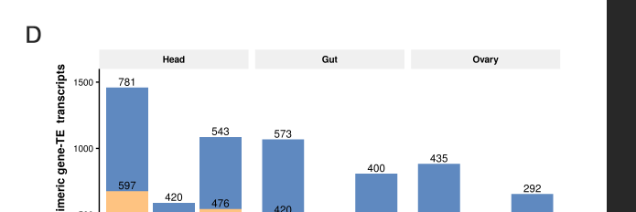

Overlap and alternative splicing insertions (n=977)
5’/3’ UTRs overlapping
Splicing sites
Internal insertions (1,587)
Internal insertions (n=1,587)
5’/3’ UTRs
Internal insertions
Other exons
Significant enrichment for short insertions (<120bp, p-value < 0.001)
Very old insertions?
8

